Slide 1
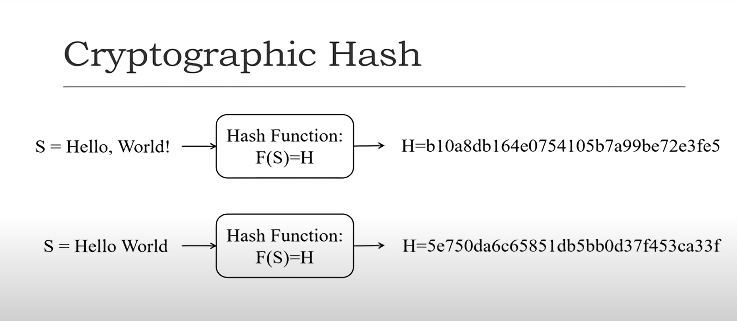
Locality Sensitive Hashing LSH

Slide 2
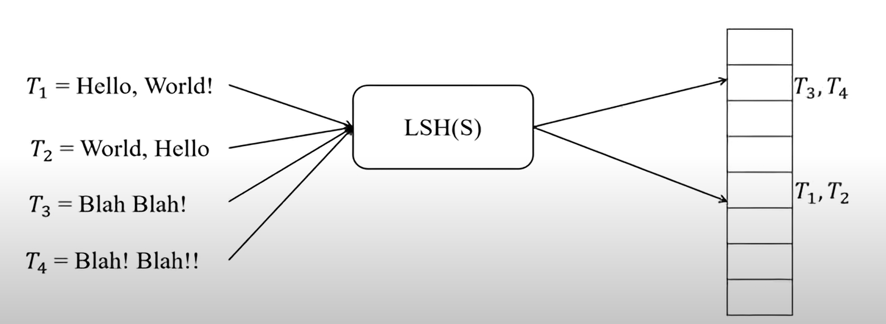
Locality Sensitive Hashing LSH

Slide 3
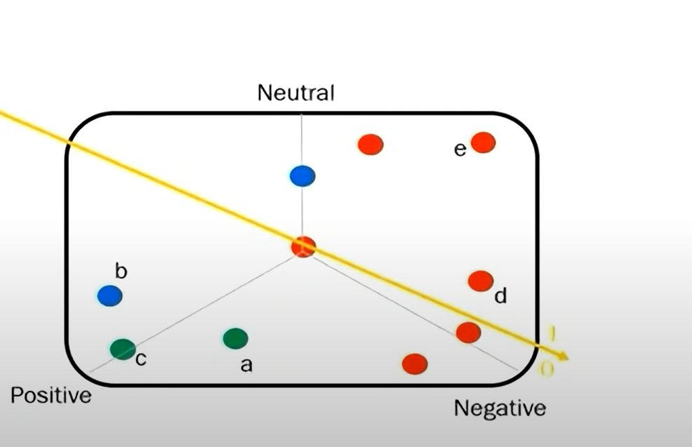
Locality Sensitive Hashing LSH

Slide 4
Locality Sensitive Hashing LSH

